Slide 1



COLOSSUS
HACKATHON
GDSC
Chapter - Dr.AIT
NanoGram
The TechHub
Team Details
Team Name – Error_Code_4
Team Leader Name – Meha Shree
Track – Hardware
Title of the Project – Smart Home System

Slide 2

COLOSSUS
HACKATHON
GDSC
Chapter - Dr.AIT
NanoGram
The TechHub
Brief About the Idea
The problem :
Energy Inefficiency: Households often waste energy by leaving lights and fans on unnecessarily, leading to higher costs and environmental impact. Along with this most household do not have any harmful gas monitoring system.
Inadequate Security and Comfort: Traditional systems lack automation for comfort control and fail to provide real-time, remote surveillance for home security.
The solution :
Smart Energy and Comfort Management: The system uses motion sensors and weather data to automatically control lights and fan speed, optimizing energy use and indoor comfort. And gas sensors for harmful gas detection.
Integrated Security System: The system includes a surveillance camera and ESP32-based automation, allowing for real-time monitoring, secure, safe and efficient home management.

Slide 3
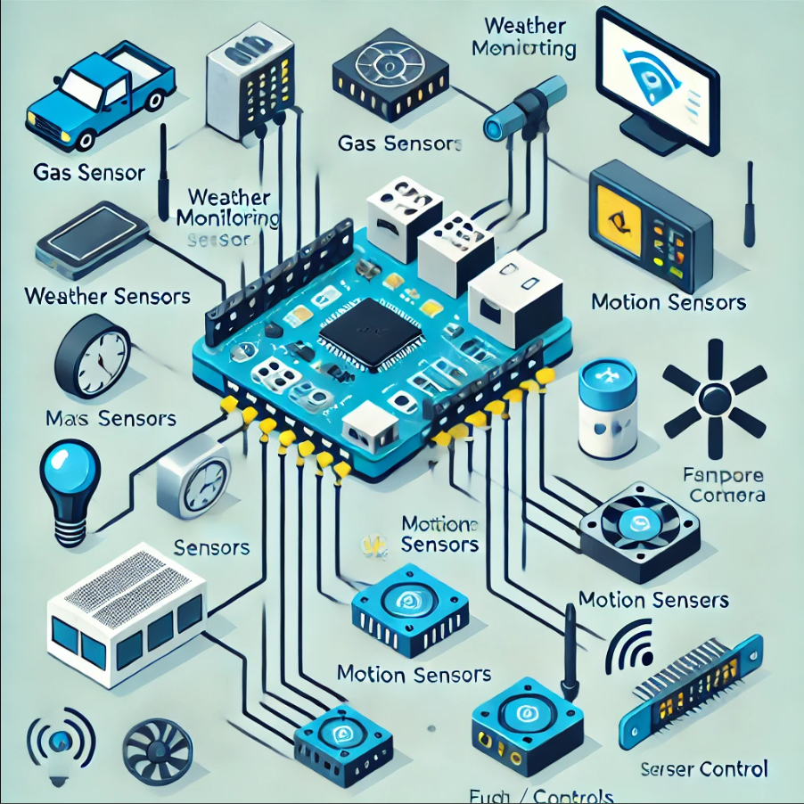
COLOSSUS
HACKATHON
GDSC
Chapter - Dr.AIT
NanoGram
The TechHub
What problem the project aims to solve?
The issue :
The project targets the inefficiency and inconvenience in managing home energy use, climate control, and security. Traditional home systems often require manual operation, leading to energy waste, inconsistent indoor comfort, and insufficient real-time security measures, and no warning systems for gas leak detection.
Explain its significance:
Addressing this problem is crucial for reducing energy consumption, lowering electricity costs, and enhancing home security. In an era of rising energy prices and increasing security concerns, optimizing these aspects can lead to significant economic and safety benefits for homeowners.
By solving these issues, the project can help create a more sustainable, comfortable, safe and secure living environment, contributing to both individual well-being and broader environmental goals.

Slide 4
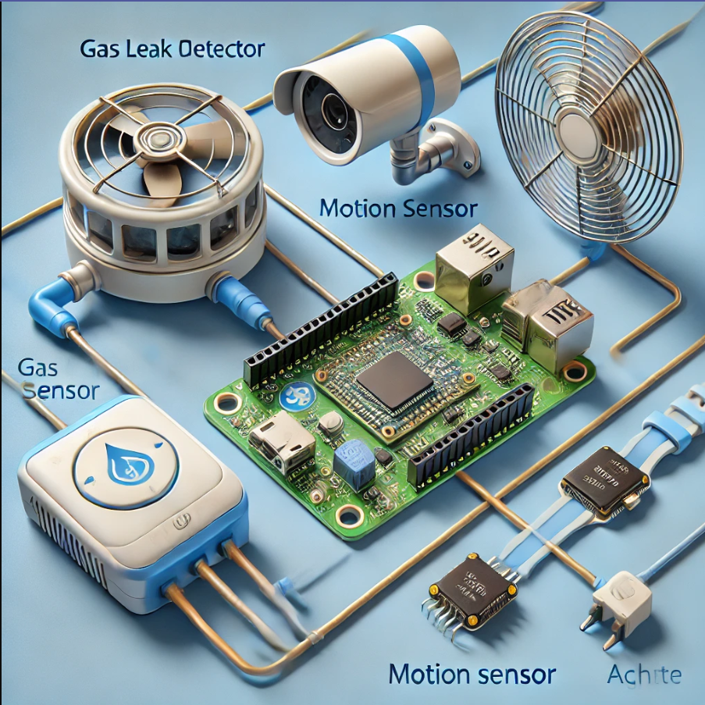
COLOSSUS
HACKATHON
GDSC
Chapter - Dr.AIT
NanoGram
The TechHub
How different is it from any of the other existing ideas?
What makes it unique ?
Multi-Functionality: It provides some home automation features along with safety and security. The key feature being smoke and harmful gas leak detection.
Local weather monitoring: Short range weather monitoring which provides more accurate data where satellite weather systems fail.
Easy Installation : It can be installed in any existing household without any expert skillset.
Cost Effective : The ESP-32 and IOT sensors used reduce the cost of production.
User friendly: All the feature can be made remotely accessible by the use of web services.
Comparative features :
Existing Systems often focus on only a single functionality either energy efficiency, security or gas leak/smoke detection systems.
Our System offers a comprehensive, all-in-one approach that addresses multiple aspects of home management, making it more efficient and protective.

Slide 5
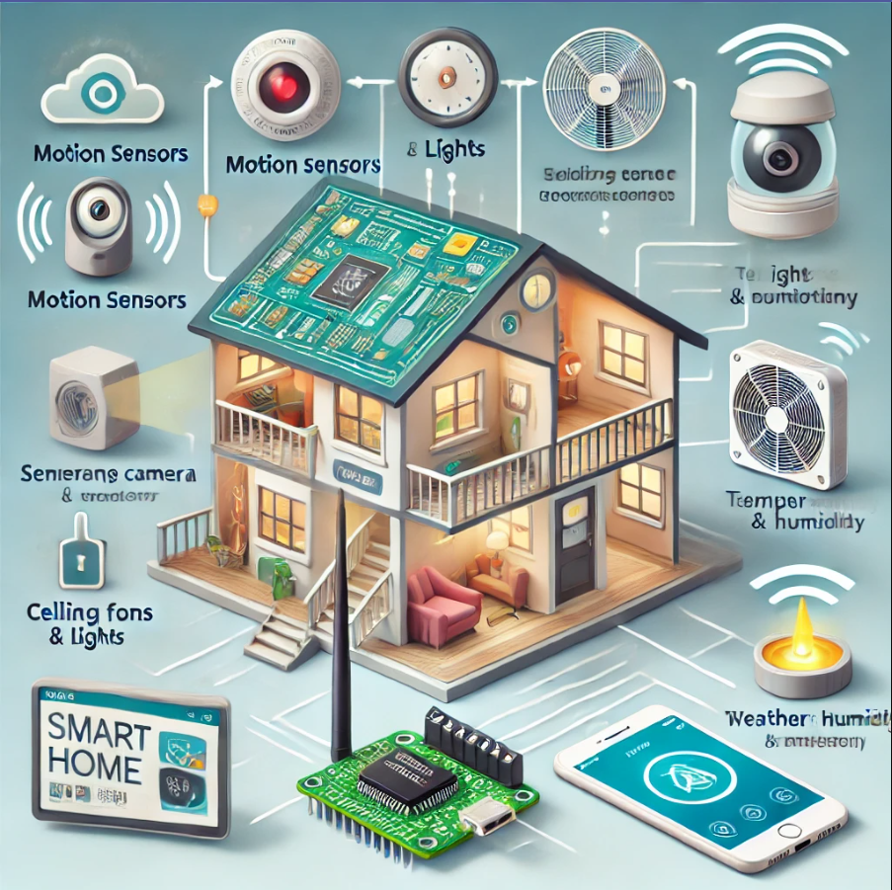
COLOSSUS
HACKATHON
GDSC
Chapter - Dr.AIT
NanoGram
The TechHub
What are the key features that the Solution offer?
Core functionalities :
Weather-Based Automation: Automatically adjusts fan speed and lighting based on temperature and humidity data.
Motion Detection: Controls lights and fans based on room occupancy to save energy.
Gas Leak Detection: Alerts users to potential gas leaks for enhanced home safety.
Surveillance Camera: Provides real-time monitoring and security alerts.
ESP32 Control: Centralizes management of all sensors and automation processes.
User Interface: Allows remote monitoring and control via smartphone or web.

Slide 6
COLOSSUS
HACKATHON
GDSC
Chapter - Dr.AIT
NanoGram
The TechHub
What are the key features that the Solution offer?
Benefits:
Enhanced Security: Real-time surveillance and motion detection for improved home security.
Energy Efficiency: Automated control of lighting and fans based on weather and occupancy to save energy.
Convenience: Automated and remote control of home systems for increased comfort.
Proactive Maintenance: Early detection of issues like gas leaks for timely intervention.
Customization: Adjustable settings to fit individual preferences and needs.
Integration: Compatibility with other smart home devices for a seamless experience.

Slide 7
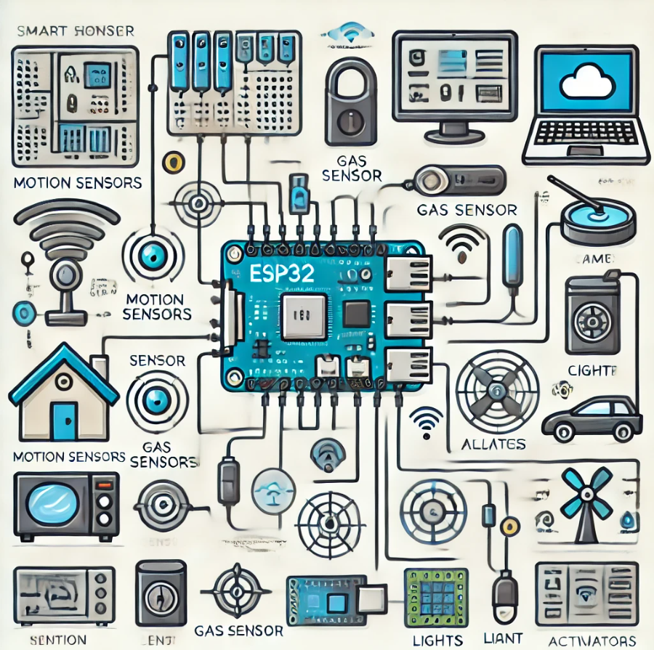
COLOSSUS
HACKATHON
GDSC
Chapter - Dr.AIT
NanoGram
The TechHub
Technologies to be used in the solution
IoT Sensors : DHT 11, LDR and MQ2 sensor, PIR sensor.
Aurdino Ide : Programming.
Thing Speak : Analyze data from various sensors.
ESP 32 : Microcontroller used for remote control and access.
Relay and Motor Driver: For light and fan control.
Flask and HTML: For web interface and remote alarm system.

Slide 8
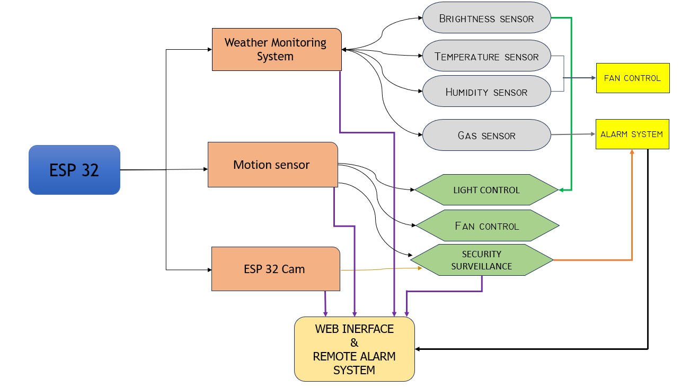
COLOSSUS
HACKATHON
GDSC
Chapter - Dr.AIT
NanoGram
The TechHub
Architecture diagram of the proposed solution

Slide 9
COLOSSUS
HACKATHON
GDSC
Chapter - Dr.AIT
NanoGram
The TechHub
Team Members Details
Team Lead
Team Member 2
Name : Meha Shree
College : Dayanada Sagar College of Engineering
Email : mehashree263@gmail.com
Name : Mallikarjun
College : Dayanada Sagar College of Engineering
Email: mallushegaji7999@gmail.com
Team Member 3
Team Member 4
Name : Maheswar Reddy.O
College : Dayanada Sagar College of Engineering
Email :maheswar.reddi2004@gmail.com
Name : Sudarshan D. Pai
College : Dayanada Sagar College of Engineering
Email : sudarshandpai@gmail.com

Slide 10
COLOSSUS
HACKATHON
GDSC
Chapter - Dr.AIT
NanoGram
The TechHub
Thank You

